Slide 1
Predicting Home prices
Dev SIngh

Slide 2
Background
Buying a house is one of the biggest purchases many people make.
Many emotions are tied to buying your first house (large down payment, housing inspection, getting the right price).
What if you could eliminate the uncertainty of knowing if you overpaid (or conversely put in too low of an offer).

Slide 3
Hypothesis
Depending on the market, housing prices can be impacted by a number of factors (e.g. New York City vs Fort Worth, Texas will show drastically different prices for similar houses).
To limit the complexity of the analysis I have limited this analysis to King County, Washington.
My hypothesis is housing prices will be positively associated with the square footage of the house.

Slide 4
Data source and Features
Data was sourced from Kaggle with a few features including date, ID, latitude, and longitude removed. For this analysis, I felt that these were not important.

Slide 5
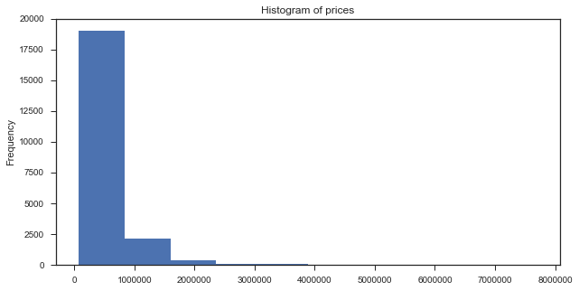
Exploratory analysis
Price data is not normally distributed.
Data is positively skewed.

Slide 6
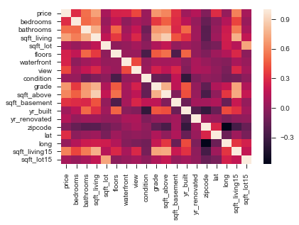
Correlation heat map
From the heatmap we can see ‘sqft_living’, ‘grade’, ‘sqft_above’, ‘sqft_living15’, and ‘bathrooms’ have the highest correlation to price.

Slide 7
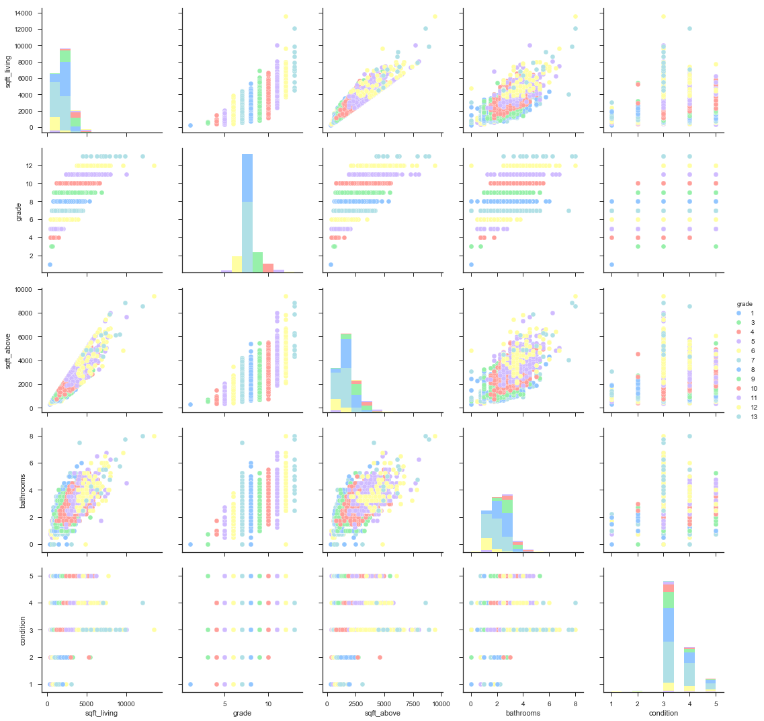
Visualizing relationship of features to price

Slide 8
Predicting House Prices
Two models:
Sci-kit learn linear regression model
Sci-kit learn random forest regressor
Model evaluation metrics:
MSE
Cross Validation Score

Slide 9
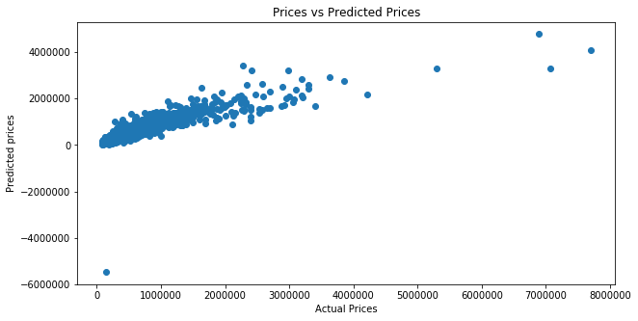
Linear regression Model

Slide 10
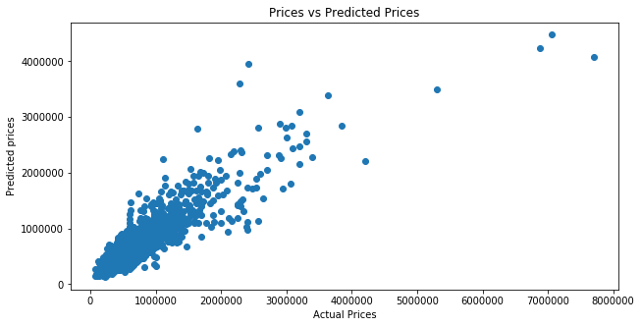
Random Forest Regression

Slide 11
Model Comparison
Linear Model:
MSE: $196,568
Cross Validation Scores: [-8.72 0.67 0.8 ]
Random Forest Model:
MSE: $177,470
Cross Validation Scores: [ 0.75 0.66 0.72]

Slide 12
Analysis
Random Forest model performed better by both metrics.
Random Forest validated our hypothesis and heat map from earlier that the size of a house (square foot) is an important feature in predicting the price.
Both models performed worse when feature zipcode was removed (larger error), indicating that the zipcode had an influence on the price as well.

Slide 13
Caveats and Future analysis
There is the possibility of multi-collinearity between features when using the heat map. I did not adjust my model for this.
I only removed a few select features for simplicity, but in the future I could attempt feature engineering.
More robust house sales data to improve model – features including: school rating, property taxes, and additional categorical variables (new construction).

